Slide 1
Memory-augmented Chinese-Uyghur Neural Machine Translation
Shiyue Zhang
CSLT, Tsinghua University; Xinjiang University
Co-work with Gulnigar Mahmut, Dong Wang, Askar Hamdulla

Slide 2
Outline
Introduction
Attention-based NMT
Memory-augmented NMT
Experiments
Conclusions
Future work
Reference

Slide 3




Introduction
Uyghur is a minority language in China, mainly used in Xinjiang Province
Chinese-Uyghur/Uyghur-Chinese translation
Challenges:
Common for minority languages
Large vocabulary
Syntactic order
Low resource
Uyghur: Subject-object-verb (SOV)
Chinese: Subject-verb-object (SVO)
Agglutinative nature of Uyghur
30,000 root words, 8 prefixes, more than 100 suffixes
Common for many languages

Slide 4
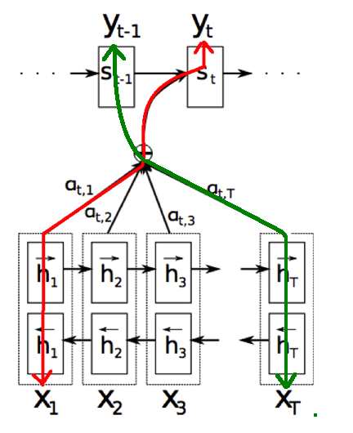
Introduction
Previous works:
Statistical Machine Translation(SMT)
Low resource, Small dataset
Phrase-based Machine Translation
Phrase mappings + language model
?
Our choice:
Neural Machine Translation (NMT)
Attention-based NMT
Meaning-oriented method
Not perfect!

Slide 5
Introduction
Out of Vocabulary (OOV)
Let’s say the number of Chinese words in training set is 130,000.
SMT
 |  |  |  |  | ...
Vocabulary = 130,000
NMT
 |  |  |  |  | ...
Vocabulary = 30,000
”UNK”

Slide 6
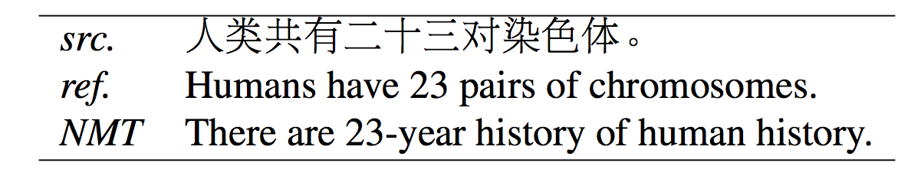
Introduction
Rare words
NMT gives a reasonable translation, but the meaning drifts away.
Overfits to frequent observations, while overlooks rare ones.
An experiment: after decoding training set, 30,000 English vocabulary shrinks to 26911. ~3,000 rare words are smoothed out.
Chinese-Uyghur/Uyghur-Chinese translation
will aggravate OOV and rare word problem

Slide 7
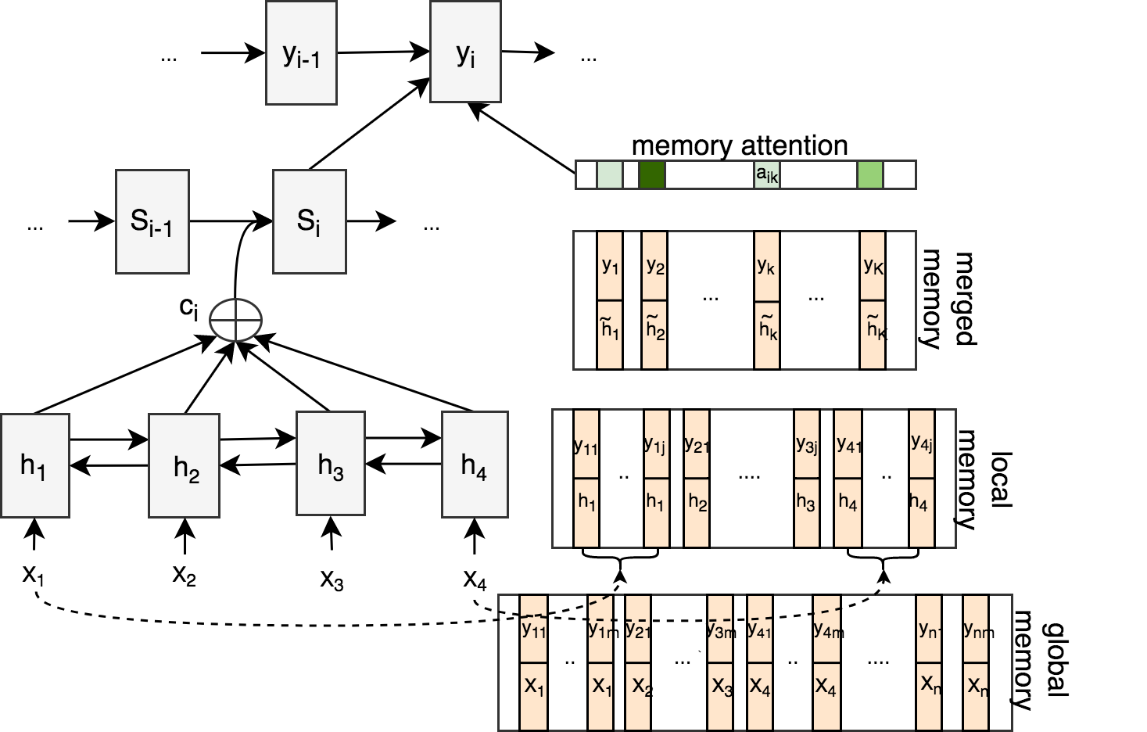
Introduction
Our aim: To address the rare and OOV word problem
Our method: augment NMT with a memory component which memorizes source-target word mappings.
It’s like equipping a translator with a dictionary.

Slide 8
Outline
Introduction
Attention-based NMT
Memory-augmented NMT
Experiments
Conclusions
Future work

Slide 9
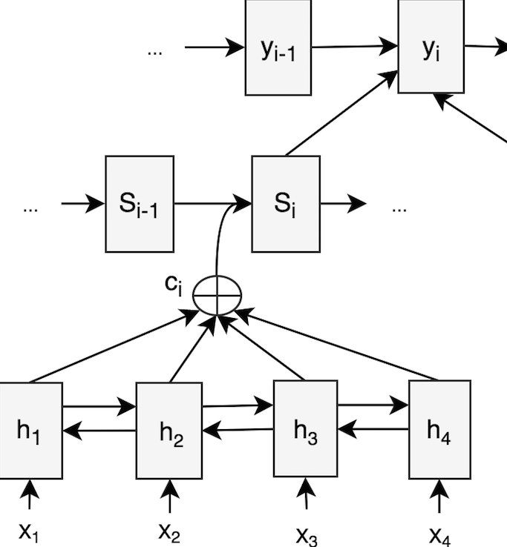
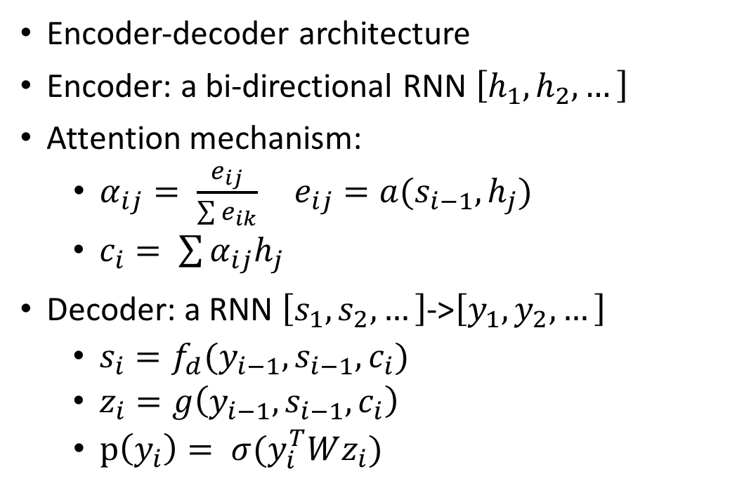
Attention-based NMT
Encoder-decoder architecture
Encoder: a bi-directional RNN $\left[h_{1}, h_{2}, …\right]$
Attention mechanism:
$α_{ij}= \frac{e_{ij}}{\sum{e_{ik}}} e_{ij}=a(s_{i−1}, h_{j})$
$c_{i}= \sum{α_{ij}h_{j}}$
Decoder: a RNN $\left[s_{1}, s_{2}, …\right]$->$\left[y_{1}, y_{2}, …\right]$
$s_{i}=f_{d}(y_{i−1}, s_{i−1}, c_{i})$
$z_{i}=g\left(y_{i−1}, s_{i−1}, c_{i}\right)$
$p\left(y_{i}\right)= σ(y_{i}^{T}Wz_{i})$
Attention weights
Context vector

Slide 10
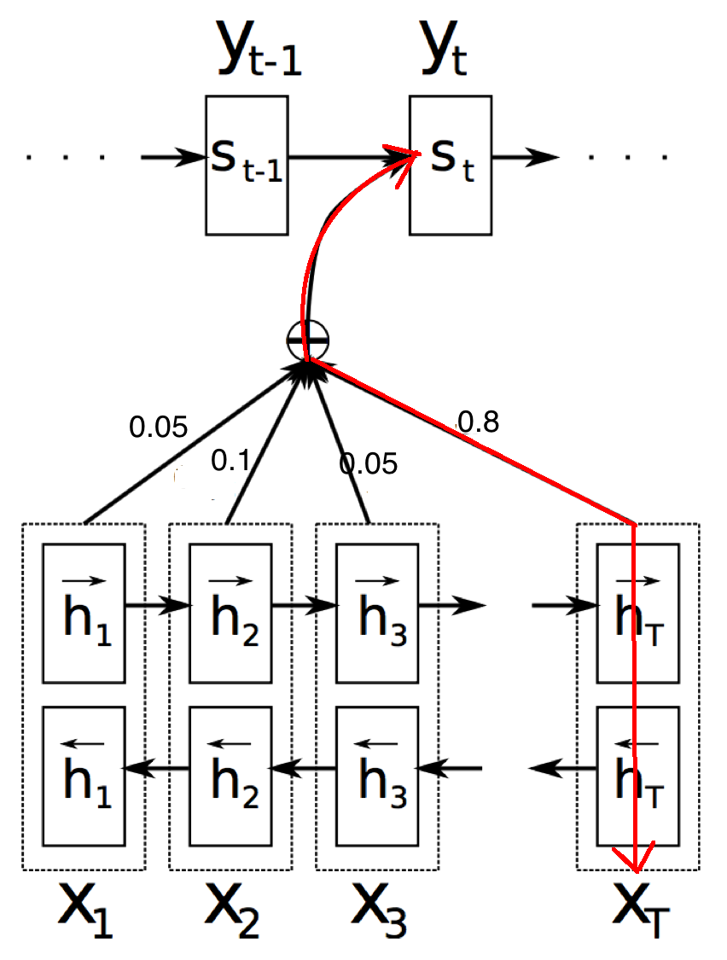
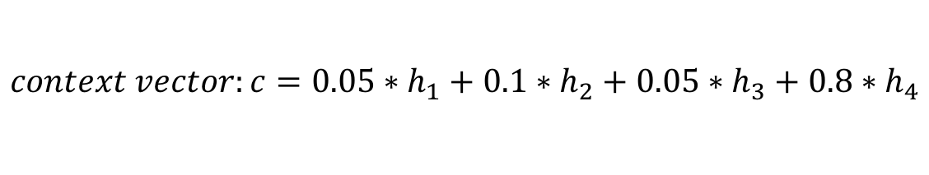
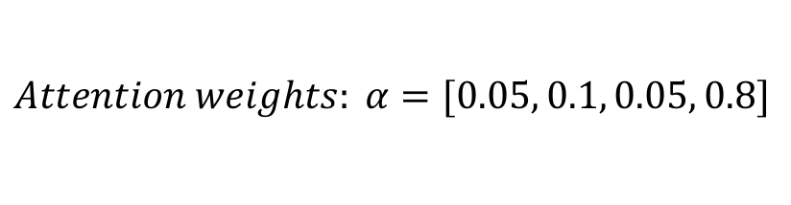
Attention-based NMT
$$context vector:c=0.05∗h_{1}+0.1∗h_{2}+0.05∗h_{3}+0.8∗h_{4}$$
$$Attention weights: α=[0.05, 0.1, 0.05, 0.8]$$

Slide 11
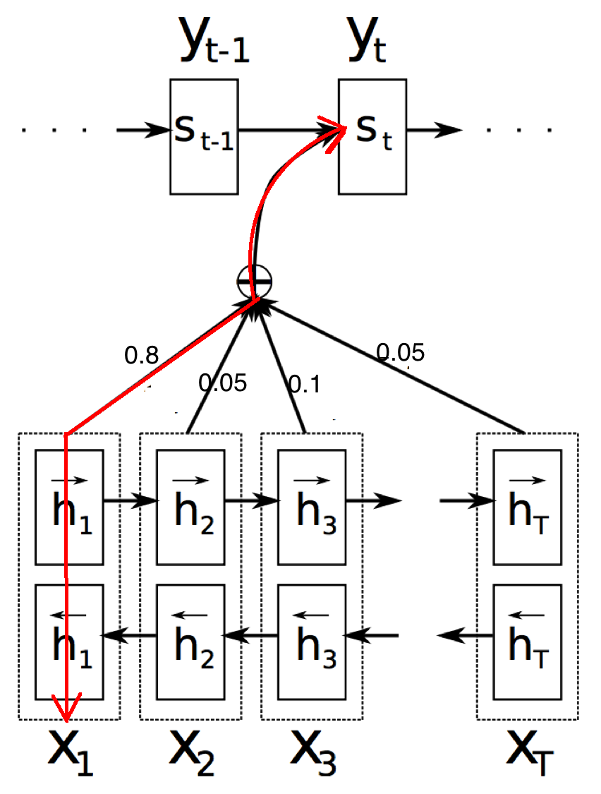
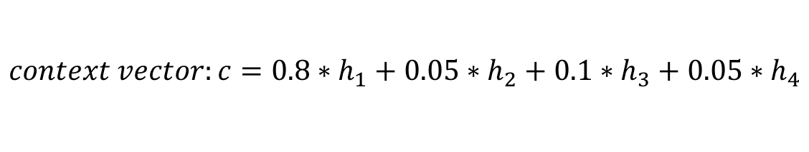
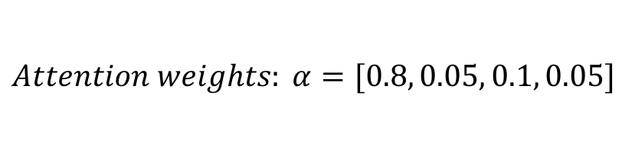
Attention-based NMT
$$context vector:c=0.8∗h_{1}+0.05∗h_{2}+0.1∗h_{3}+0.05∗h_{4}$$
$$Attention weights: α=[0.8, 0.05, 0.1, 0.05]$$

Slide 12
Outline
Introduction
Attention-based NMT
Memory-augmented NMT
Experiments
Conclusions
Future work

Slide 13
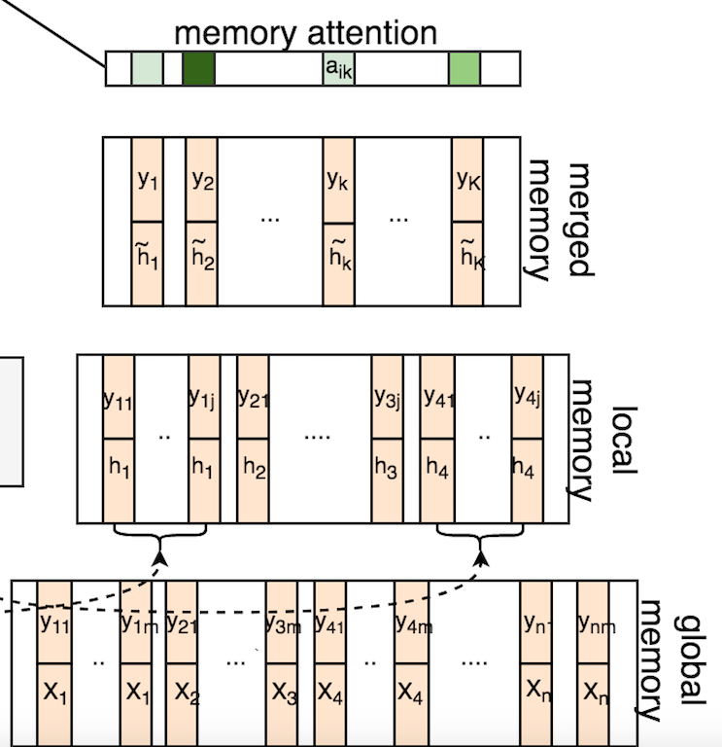
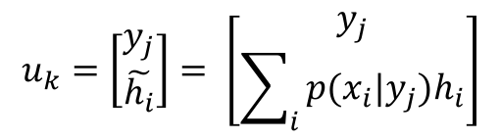
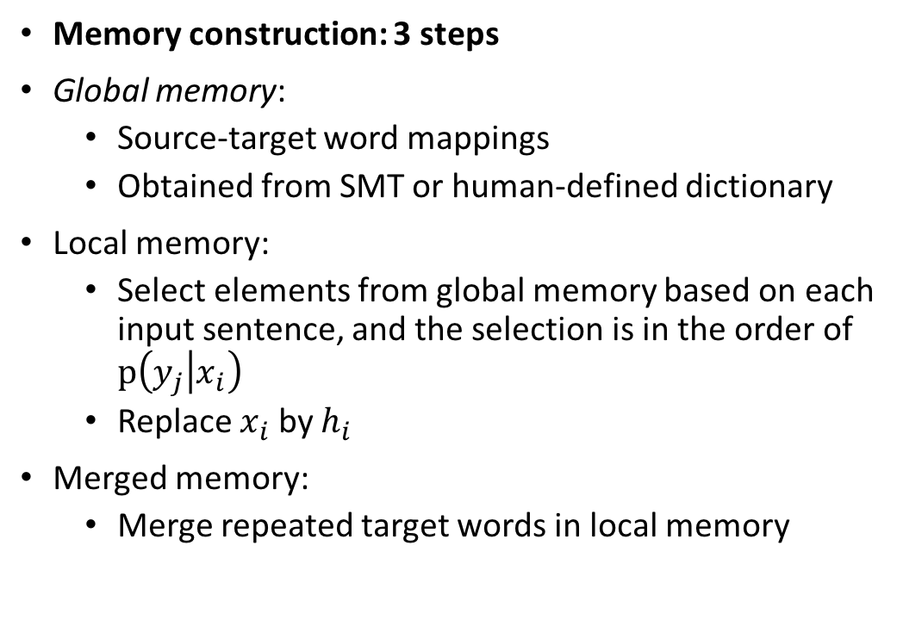
Memory-augmented NMT
Memory construction: 3 steps
Global memory:
Source-target word mappings
Obtained from SMT or human-defined dictionary
Local memory:
Select elements from global memory based on each input sentence, and the selection is in the order of $p\left(y_{j} | x_{i}\right)$
Replace $x_{i}$ by $h_{i}$
Merged memory:
Merge repeated target words in local memory
$$u_{k}=\left[\begin{matrix}y_{j} \\ \tilde{h_{i}}\end{matrix}\right]= \left[\begin{matrix}y_{j} \\ \sum_{i}{p(x_{i}|y_{j})h_{i}}\end{matrix}\right]$$

Slide 14
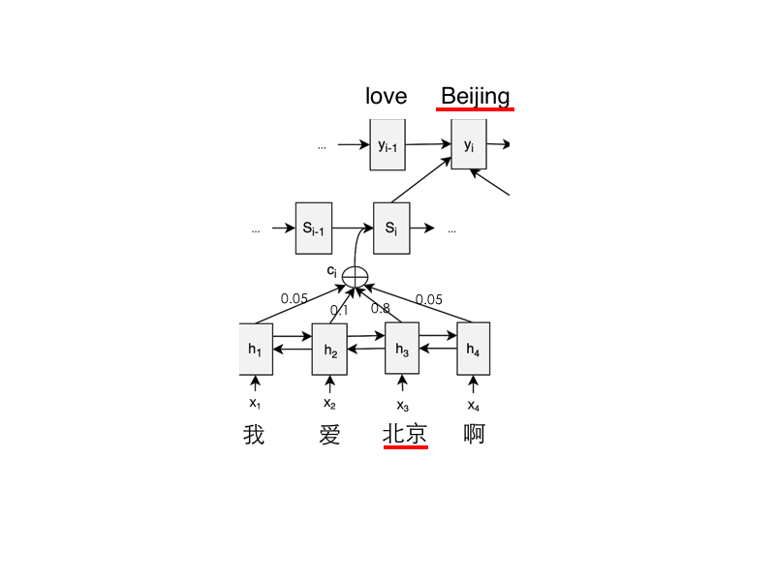
Memory-augmented NMT
i | me | my | love | like | Beijing
a*h1+((1-a)*h4 | h1 | h1 | h2 | h2 | h3
merged
memory
i | me | my | love | like | Beijing | i
h1 | h1 | h1 | h2 | h2 | h3 | h4
local
memory
i | me | my | you | your | love | like | Beijing | Shanghai | i | …
我 | 我 | 我 | 你 | 你 | 爱 | 爱 | 北京 | 上海 | 啊 | …
Global
memory

Slide 15
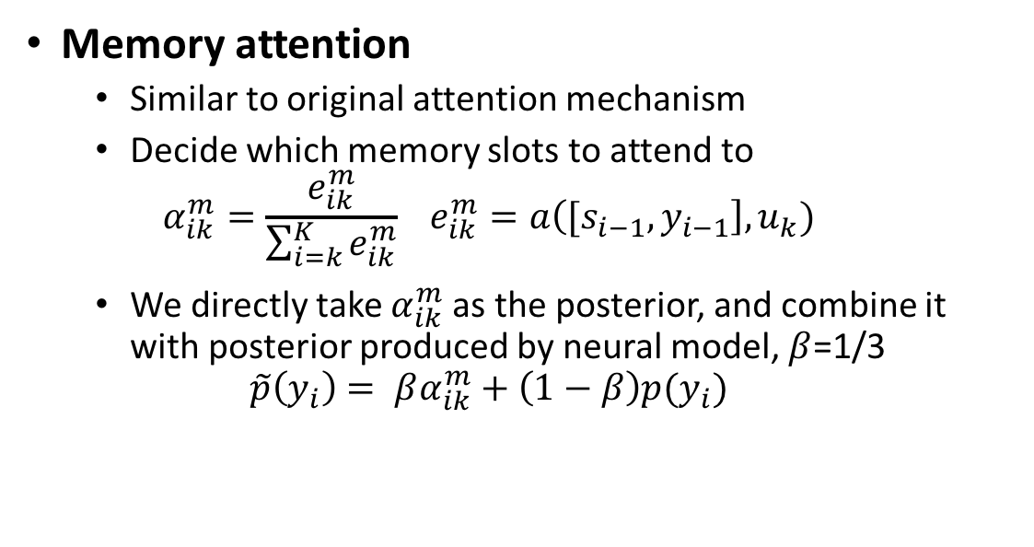
Memory-augmented NMT
Memory attention
Similar to original attention mechanism
Decide which memory slots to attend to
$$α_{ik}^{m}=\frac{e_{ik}^{m}}{\sum_{i=k}^{K}{e_{ik}^{m}}} e_{ik}^{m}=a\left({[s}_{i−1},y_{i−1}\right], u_{k})$$
We directly take $α_{ik}^{m}$ as the posterior, and combine it with posterior produced by neural model, $β$=1/3
$$\tilde{p}\left(y_{i}\right)= βα_{ik}^{m}+\left(1−β\right)p(y_{i})$$

Slide 16
Memory-augmented NMT
0.034 | 0.004 | 0.012 | 0.02 | 0.01 | 0.46 | 0.26 | 0.19
i | my | my | love | like | Beijing | Shanghai | …
0.001 | 0.001 | 0.003 | 0.005 | 0.01 | 0.3 | 0.4 | 0.28
i | my | my | love | like | Beijing | Shanghai | …
0.1 | 0.01 | 0.03 | 0.05 | 0.01 | 0.8 | 0 | 0
i | my | my | love | like | Beijing | Shanghai | …
i | me | my | love | like | Beijing
a*h1+((1-a)*h4 | h1 | h1 | h2 | h2 | h3

Slide 17
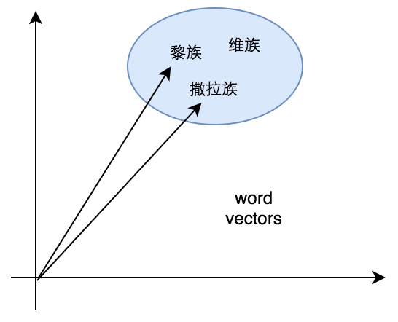
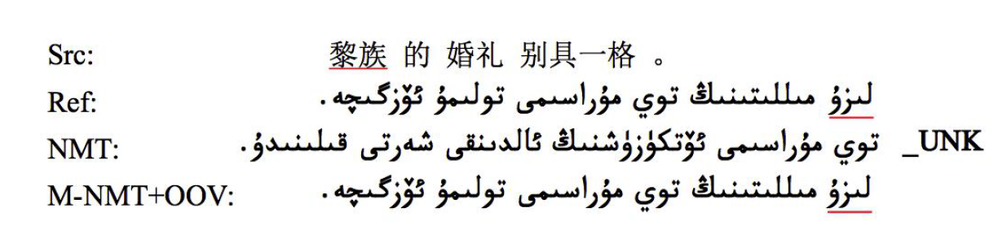




Memory-augmented NMT
OOV treatment
Represent an OOV word by its similar word in vocabulary
An example:
Src:
X
OOV
OOV

Slide 18
Outline
Introduction
Attention-based NMT
Memory-augmented NMT
Experiments
Conclusions
Future work

Slide 19
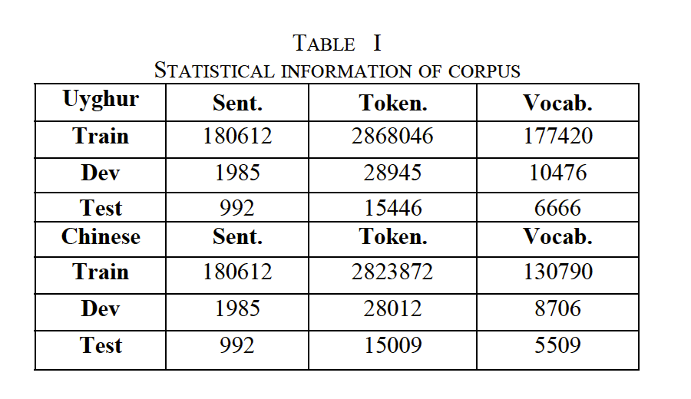
Experiments
Data:
180k sentence pairs, ~170,000 Uyghur words, ~130,000 Chinese words
Biggest parallel dataset so far.

Slide 20
Experiments
Systems:
SMT: Moses
NMT
M-NMT
Evaluation metrics:
BLEU: the average of 1-4 grams bleu multiplied by a brevity penalty

Slide 21
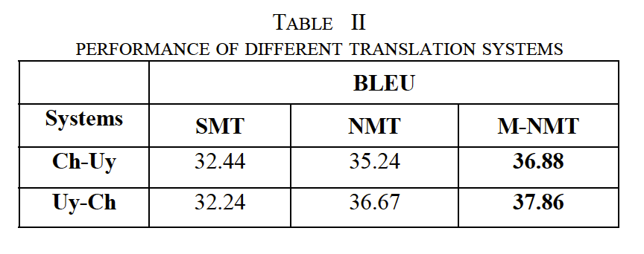
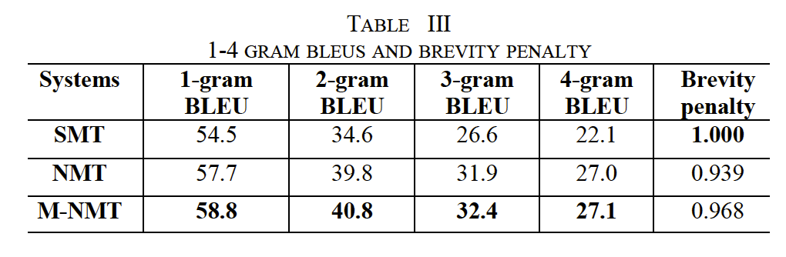
Experiments

Slide 22
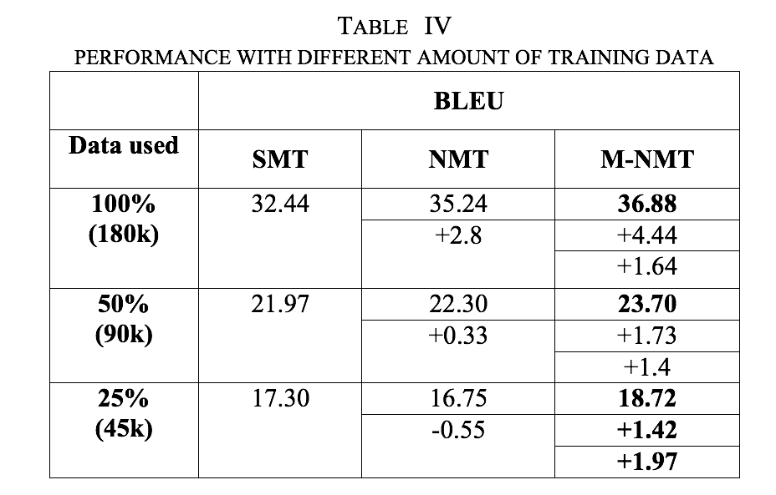
Experiments
Consistent improvement on different amount of data

Slide 23
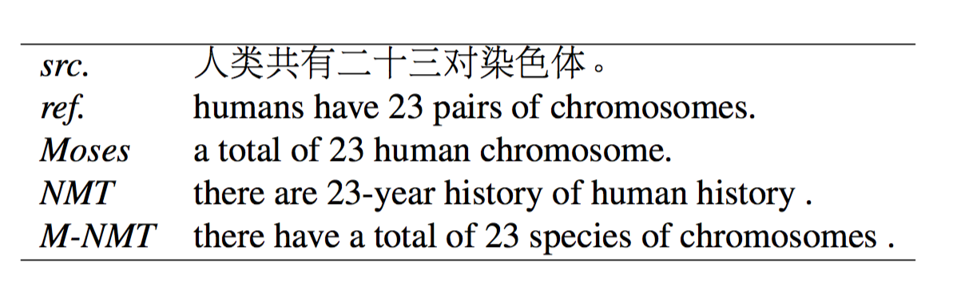
Experiments
Recall more rare words
Systems | Recalled words in test
SMT | 3680/6666
NMT | 3509/6666
M-NMT | 3560/6666
*6666 is the number of words in reference

Slide 24
Experiments
Cannot apply to the whole dataset, but performs very well for OOV name entities

Slide 25
Outline
Introduction
Attention-based NMT
Memory-augmented NMT
Experiments
Conclusions
Future work

Slide 26
Conclusions
Biggest parallel dataset
Best Chinese-Uyghur/Uyghur-Chinese translation performance
M-NMT alleviates rare word and under-translation problems in NMT.
M-NMT provides a way to address OOV problem.
M-NMT brings stable improvement on different datasets, especially on small datasets, this improvement is significant and consistent.

Slide 27
Outline
Introduction
Attention-based NMT
Memory-augmented NMT
Experiments
Conclusions
Future work

Slide 28
Future work
Better OOV treatment?
No need to do similar word replacement
Implement to the whole dataset
Phrase-based memory?

Slide 29
Thanks! Q&A

Slide 30
OOV treatment
 |  |  |  |  | 0.46
 |  |  |  |  | 0.3
0.8
h1

